Slide 1
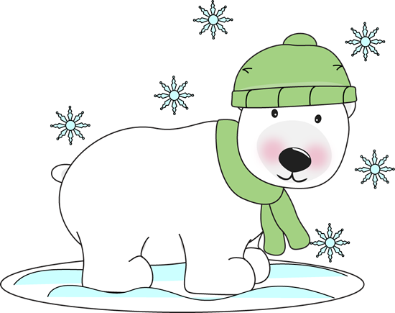
Mrs. Batts’
Weekly
Newsletter
January 27-31, 2020
lnbatts@auburnschools.org
This Week:
Reading: Poetry
This week we will read several poems and discuss what makes up a poem and how a poem is organized (lines and stanzas). Our phonics focus for this week is words with soft c and soft g. There will be a spelling test on Friday.
Math: Chapter 8 – Understand Fractions
This week we will begin Chapter 8 which focuses on the basic concepts of how fractions work.
Language/Writing: Pronoun and Antecedent, Narrative Writing
We will review what a pronoun is and how it needs to agree with its antecedent. We will also continue writing on our personal narrative piece.
Science: Weather
In science this week we will be researching different types of severe weather and natural disasters.
Vocabulary:
pounce: to leap at and surprise
scarce: few in number
briskly: quickly
edible: safe to be eaten
tolerate: to put up with
Homework:
Monday: Read 20 min., study spelling & voc., math facts 10 min.
Tuesday: Read 20 min., study spelling & voc., math facts 10 min.
Wednesday: Read 20 min., study spelling & voc., math facts 10 min.
Thursday: Read 20 min., study spelling & voc., math facts 10 min.
**Please review and sign planners each night!
Important Dates:
January 31 – Author Cassie Beasley visits OES
Spelling Words:
placed dice cents
price space officer
citizen gym giant
change message pages
cabbage gently magic

